Slide 1
Asteroid Data
Analytics Project
Group 4: Jaeline Granda, Harsh Oswal, Divya Patil
Big-Data Architecture and Governance
Notes:
Divya

Slide 2
Tools Used
Project Portfolio Management: Velero
Data Wrangling/Cleansing: Python, Pandas
Graph Database: Neo4j
Data Visualization/Dashboard: Dash, Plotly, Matplotlib, Jupyter Notebook
Notes:
Divya

Slide 3
Dataset Summary
This asteroid dataset included metrics of asteroids to find if there is a threat of collision
We came up against a common issue with data — unbalanced datasets, where most of the training data is just one class.
We analyzed the data to determine the percentage of total asteroids that are NEOs (near earth objects) and also what percentage of NEOs have orbits that cross the Earth’s orbit
The significance of this was to analyze objects that are potential impact objects
Notes:
Divya

Slide 4
Columns used for dimensions, and columns
that are used for measurement.
Dimensions
diameter
H (Absolute Magnitude )
eccentricity
inclination
Minimum orbit intersection distance(moid)
angular speed
Measures
Pha (Potentially hazardous)
Neo(Near earth object)
Notes:
Divya

Slide 5
Generating new dimensions
Using diameter and absolute magnitude we can create new dimensions for asteroids size and magnitude range classification .
Using eccentricity and inclination, we can create a new dimension for analyzing movements of asteroids and trace their path in space.
Using angular speed and Minimum orbit intersection distance(moid) we can create dimensions to predict collision threats by objects to the earth.
Newly generated dimensions are diameter_cat, H_cat,eccentricity_cat,inclination_cat, n_cat & moid_cat
Notes:
Divya

Slide 6
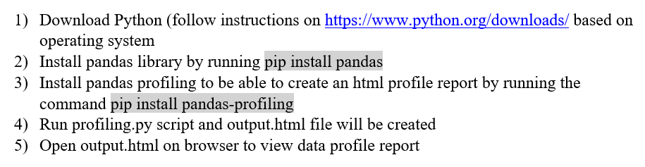
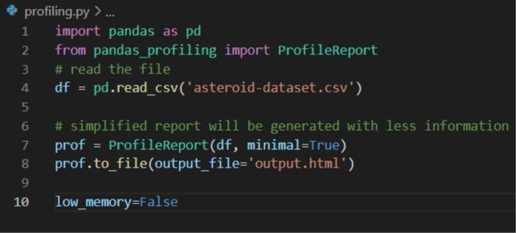
Data Profiling Instructions
Notes:
Jaeline

Slide 7
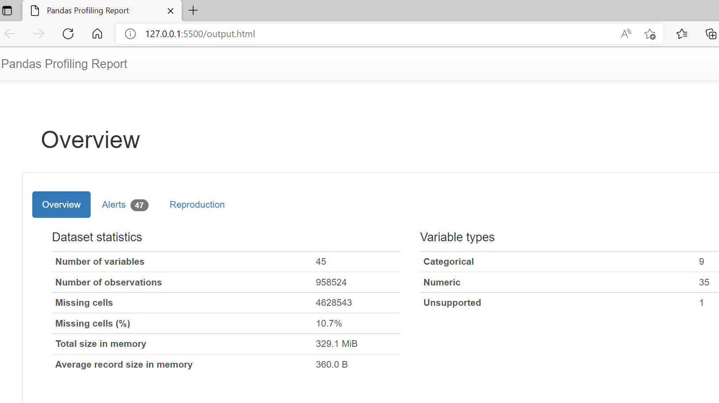
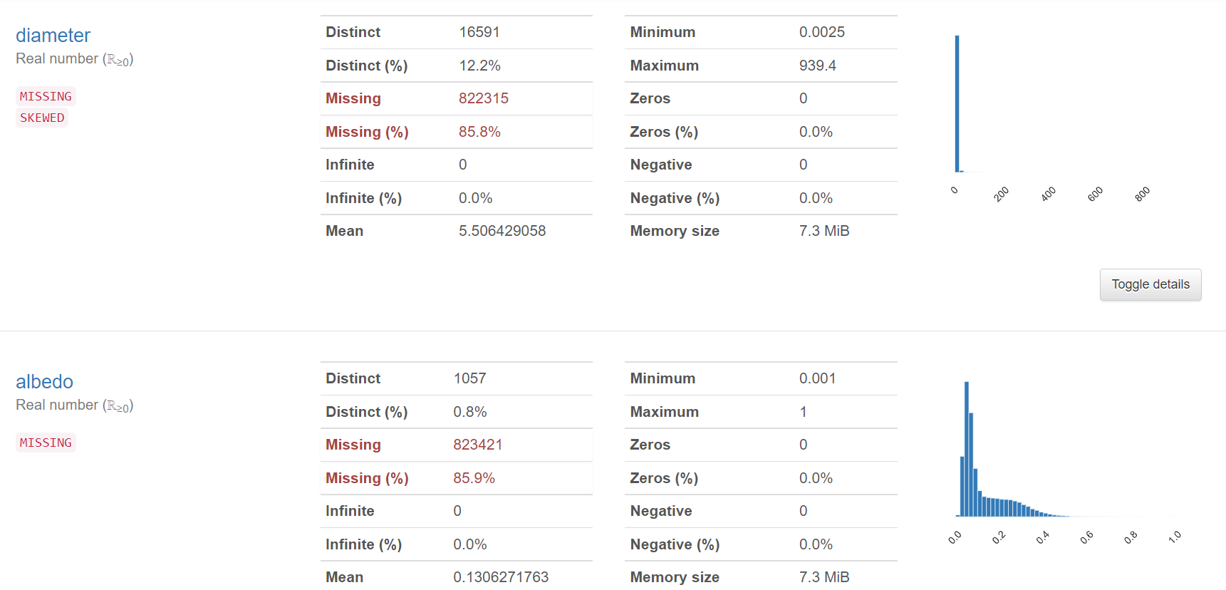
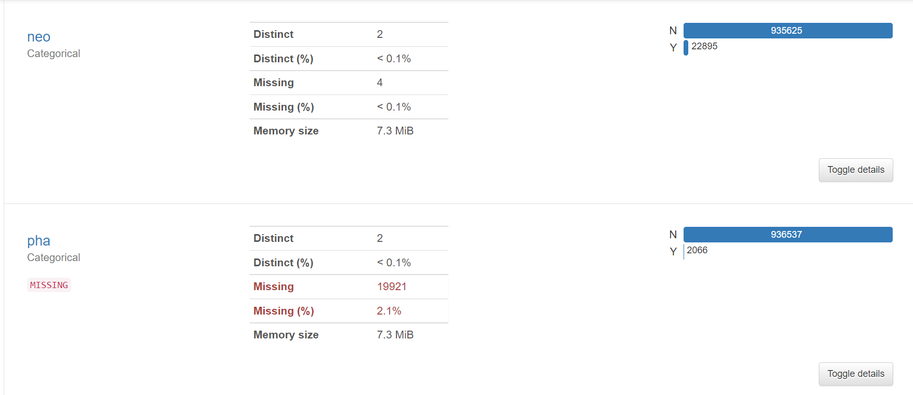
Data Profiling
Notes:
Jaeline

Slide 8
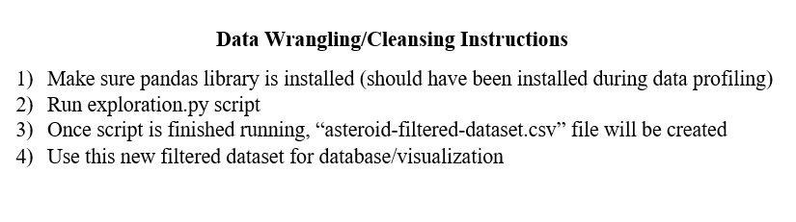
Data Wrangling/Cleansing Instructions
Notes:
Jaeline

Slide 9
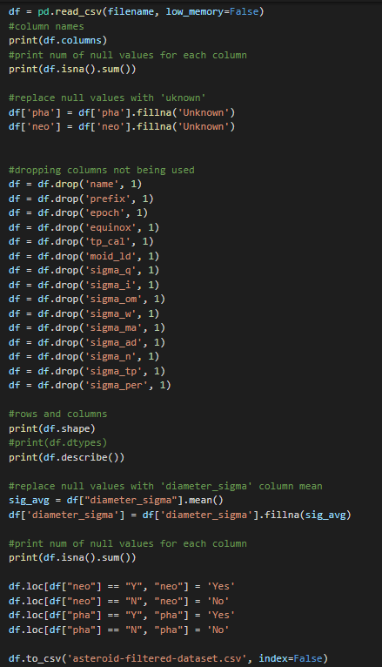
Data Wrangling/Cleansing
Checked number of null values and assessed whether to replace values (i.e. replace null value to ‘unknown’ value for analysis) or remove them
Dropped columns with sigma values and metrics that could not be understood without scientific knowledge
Altered categorical values to assist in visualization (“Yes” instead of “y” and “No” instead of ‘N’)
Created metric categorical classifications to better depict metric distributions
Checked for dates, none found
Created filtered dataset for use in database/visualization
Notes:
Jaeline

Slide 10
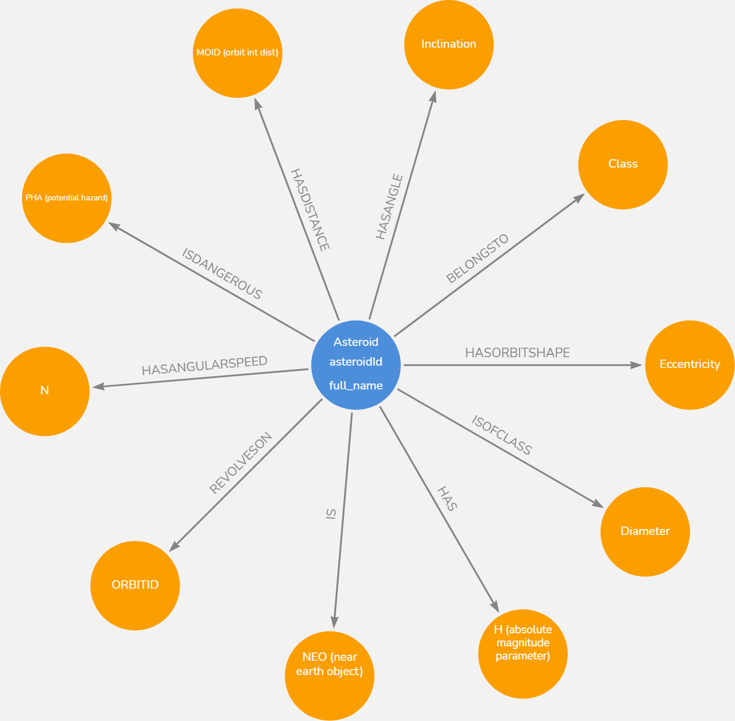
Database Design
Notes:
Harsh

Slide 11
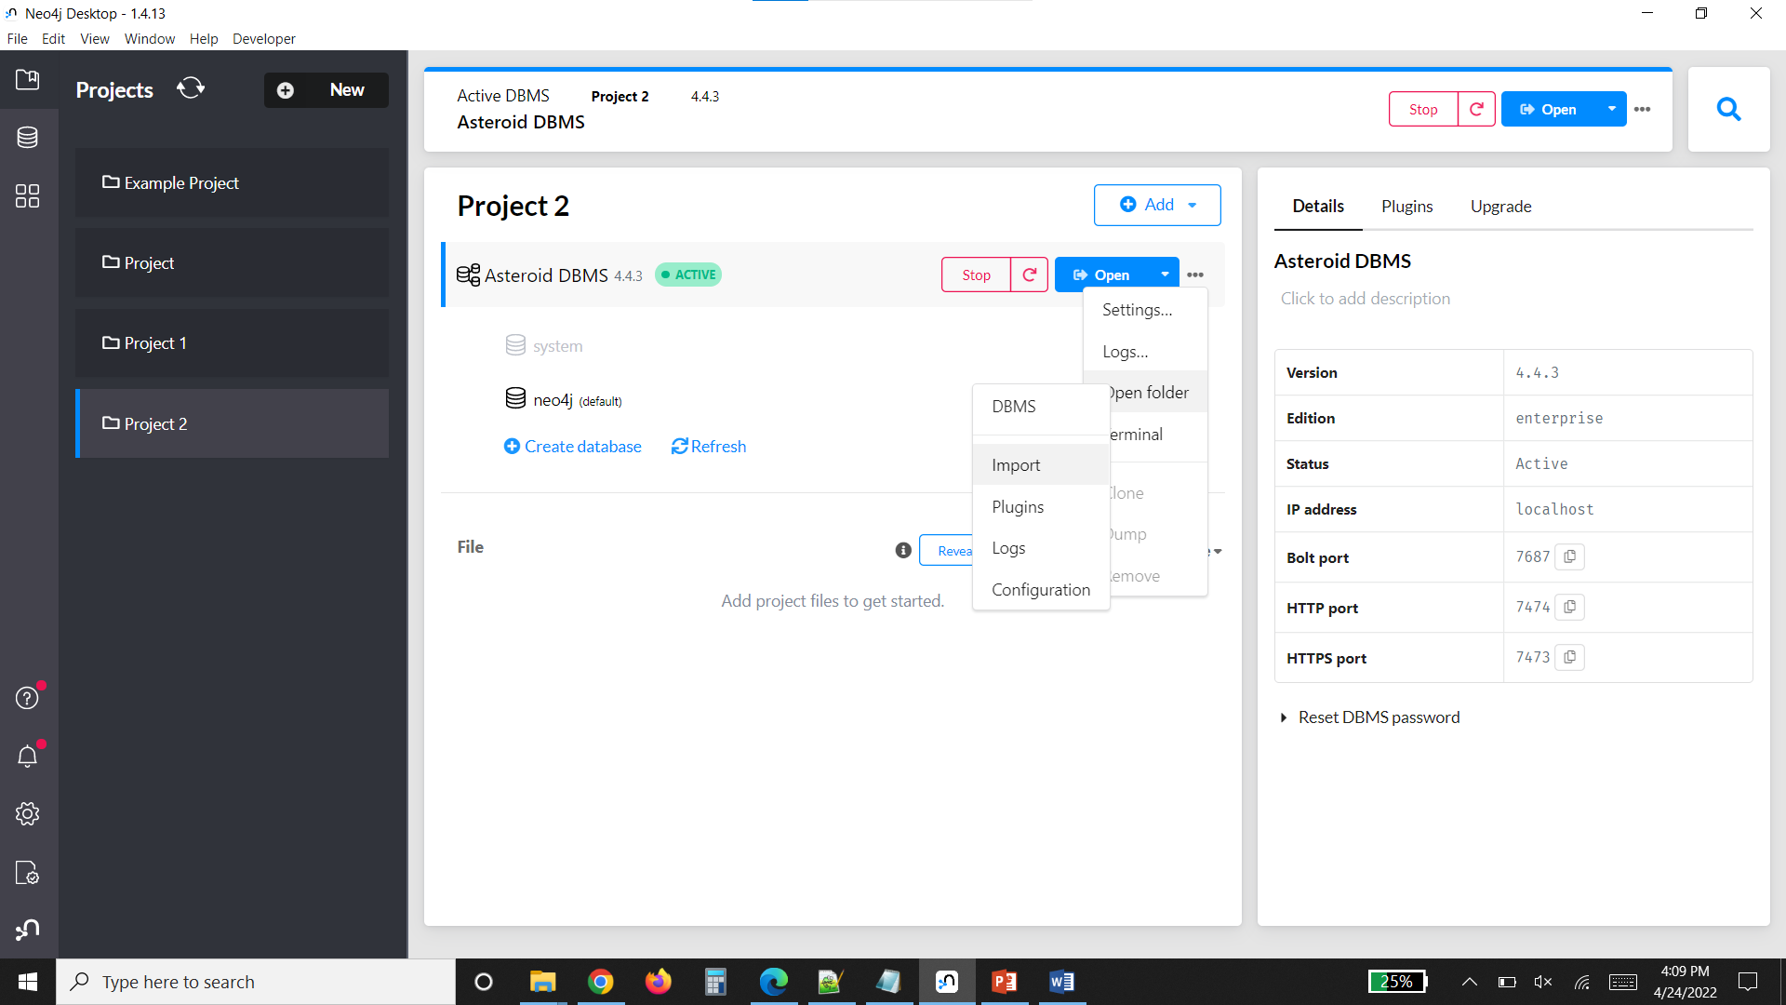
Graph Database End-User Instructions (Database creation and load)
Create a new database in Neo4j
Copy the CSV file into the dbms import folder of the database created
Start the database and open the database
Notes:
Harsh

Slide 12
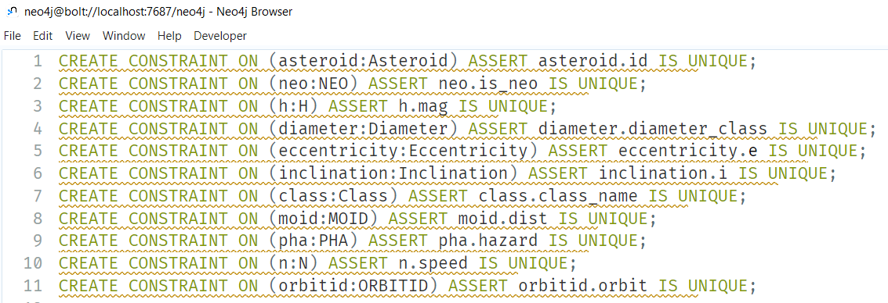
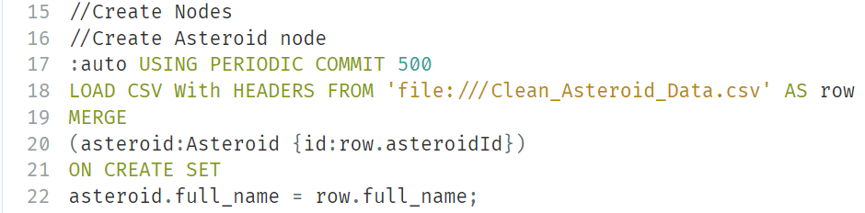
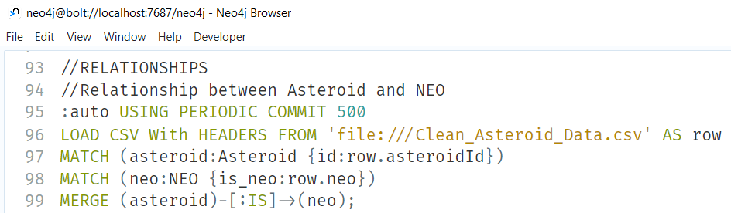
Graph Database End-User Instructions (Database creation and load cont)
Copy the cypher code(asteroid_script.txt) to create the constraints, nodes and relationships between them
Run the code to create the graph database
The scripts will run one by one and will take a few minutes due to the large dataset size
Notes:
Harsh

Slide 13
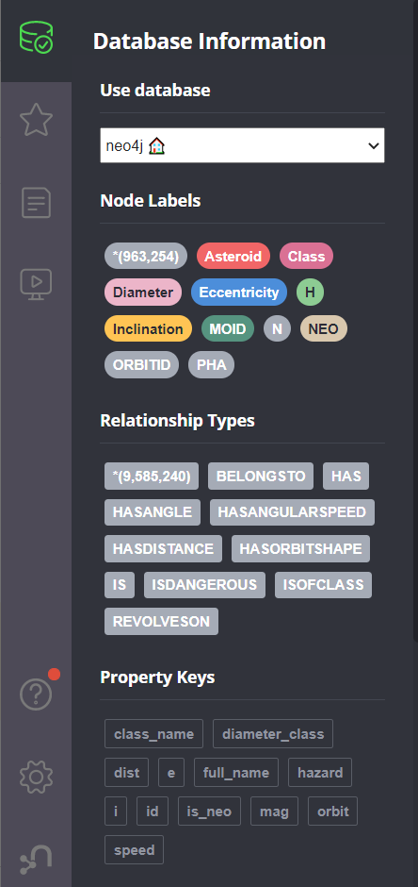
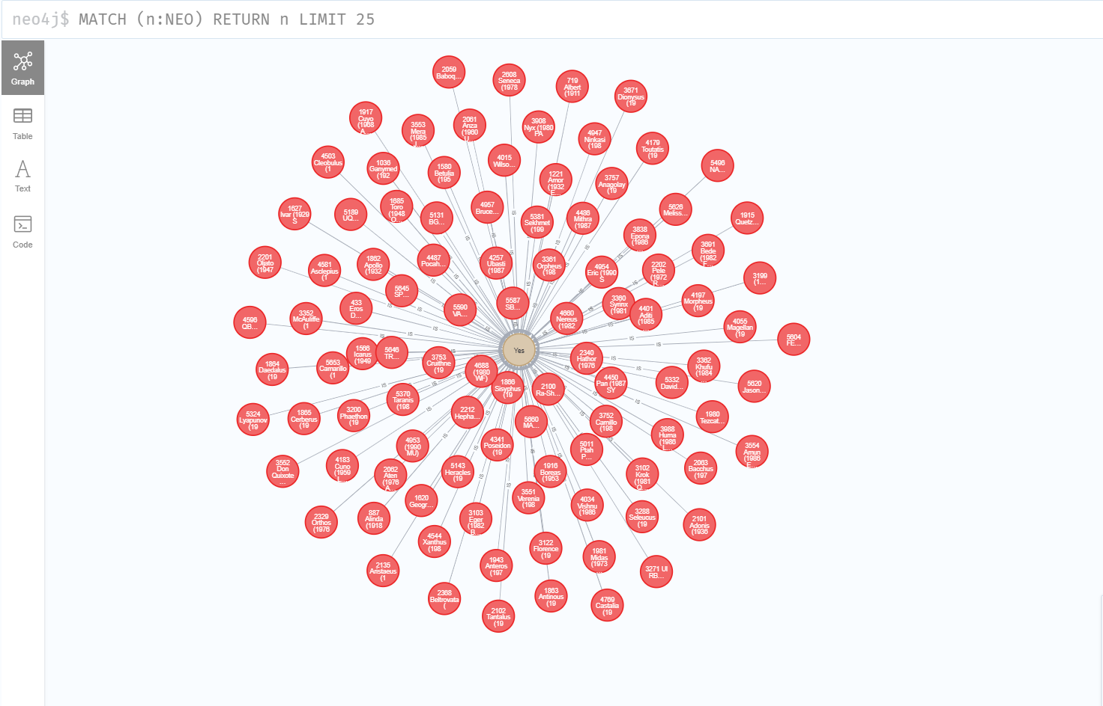
Neo4j Screenshots - Graph Database (Nodes)
Notes:
Harsh

Slide 14
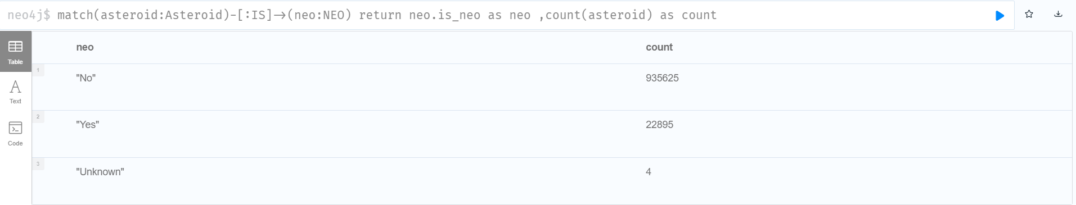
Graph Database Relationship
Notes:
Harsh

Slide 15
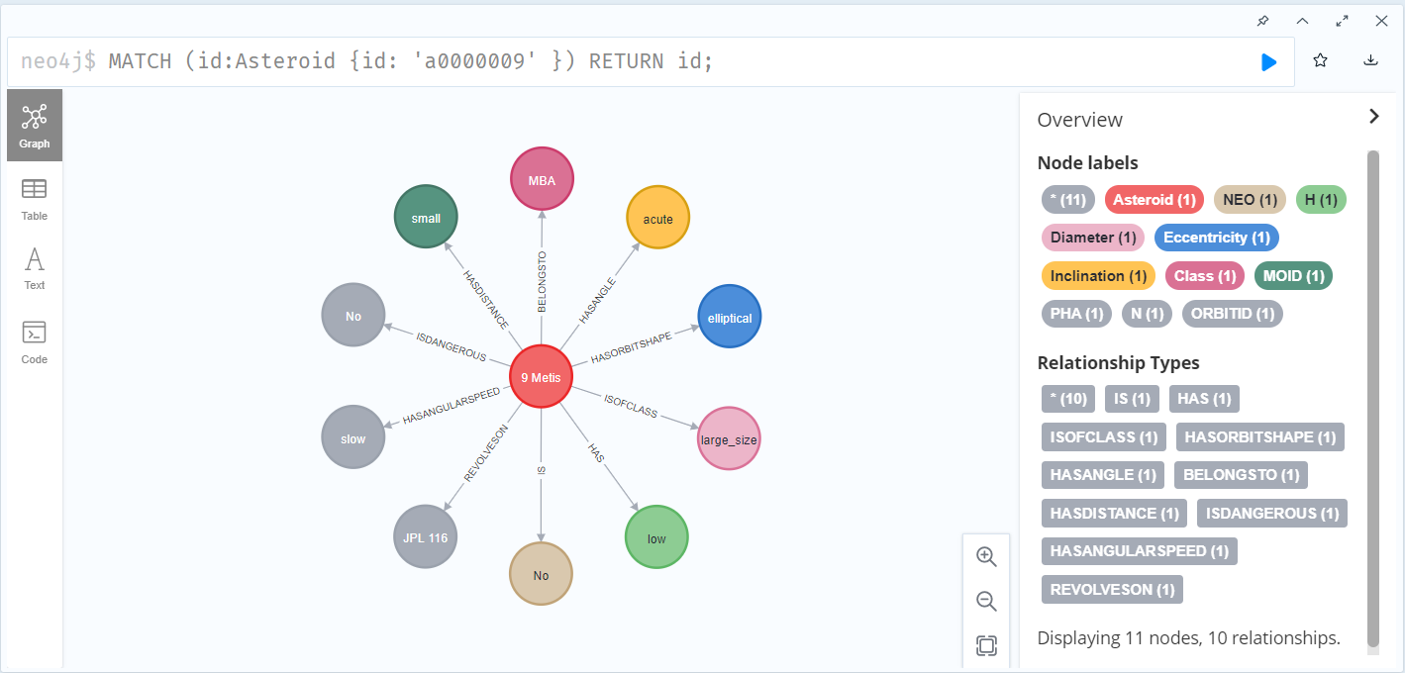
Node Relations example
Notes:
Harsh

Slide 16
Business Metadata
From a business point of view, pha(potentially hazardous asteroids) and neo( near-earth object) will help to understand which asteroids are near to the earth and whether they are dangerous to earth or not.
Full_name identifies the asteroid’s name and orbit_id represents which asteroid is revolving in which orbit and helps to locate them.
The diameter and absolute magnitude(H) column determine the size and shape of asteroids which helps to categorize them into different categories like small, medium, and large.
Columns like eccentricity and inclination help to trace the path of asteroids moving in space.
n(angular speed) corresponds to the speed of asteroids in space which helps to understand if an asteroid coming from the asteroid belt collides with the earth.
Notes:
Divya

Slide 17
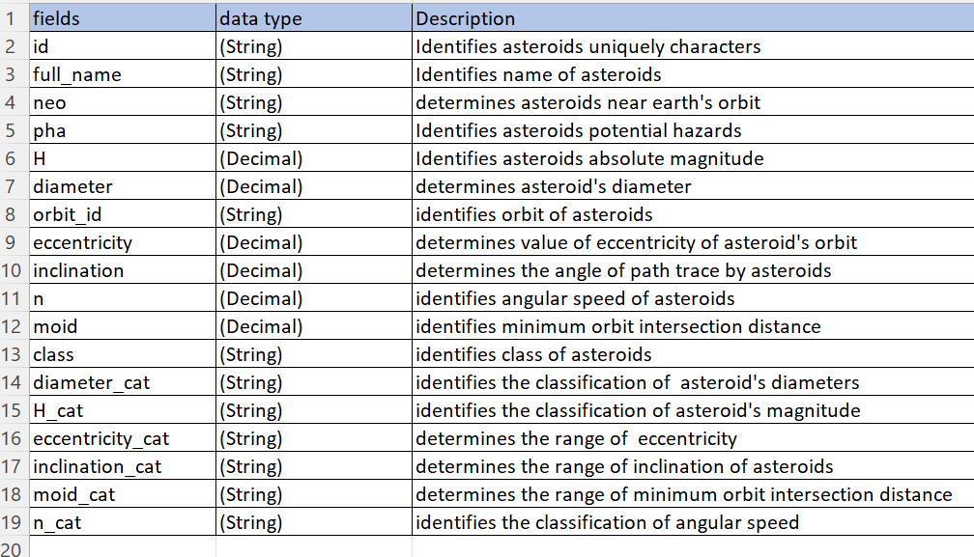
Technical Metadata
Notes:
Divya

Slide 18
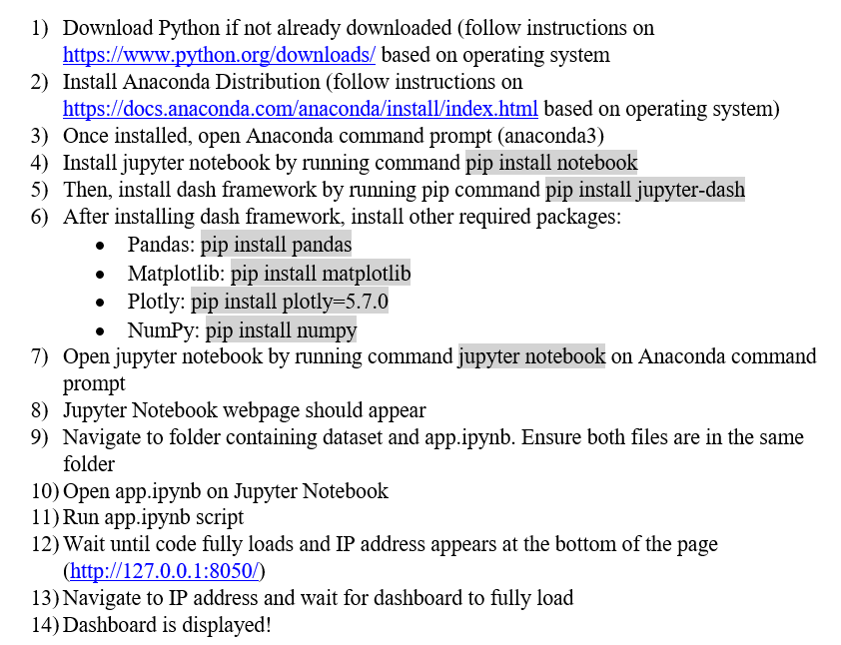
Dashboard End-User Instructions
Notes:
Jaeline

Slide 19
Dashboard Usability
Who would use this Dashboard and how would they benefit from it?
End-Users : Astronomers examining potentially hazardous asteroids based on metrics and categories
What value would be generated using this dashboard?
The data such as distance of intersection to other objects, the angular speed, nearness to earth and classification of level of magnitude, diameter and potential hazard are essential parameters for Astronomers, these attributes and their patterns can be easily identified through our dashboard at a single glance instead of requiring numerous calculations for every parameter used.
Asteroids posing danger to the earth can be focused on towards further studies.
The classification of Asteroids can help Astronomers and Astrophysicists make better decisions while planning vehicular orbital launches ensuring safety of crew and costly resources used.
These visuals will assist them in identifying and classifying Asteroids for further analysis.
Notes:
Jaeline

Slide 20
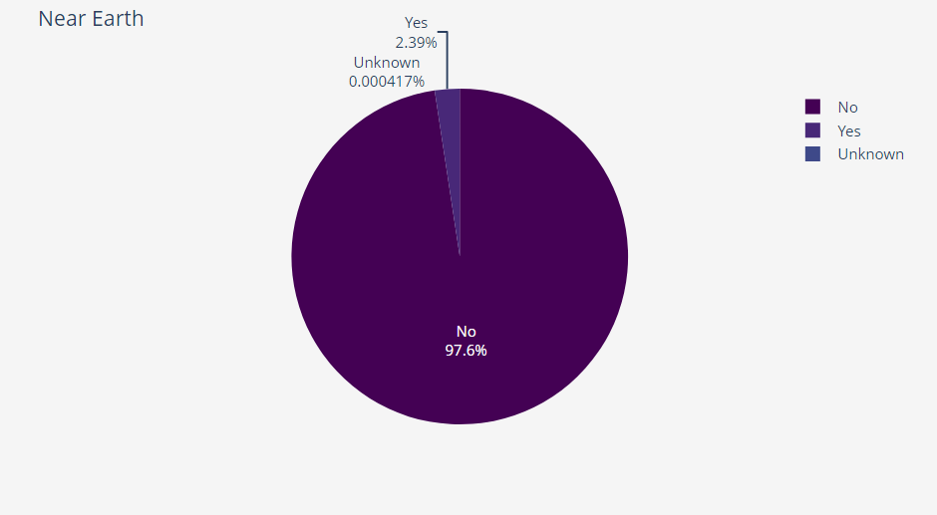
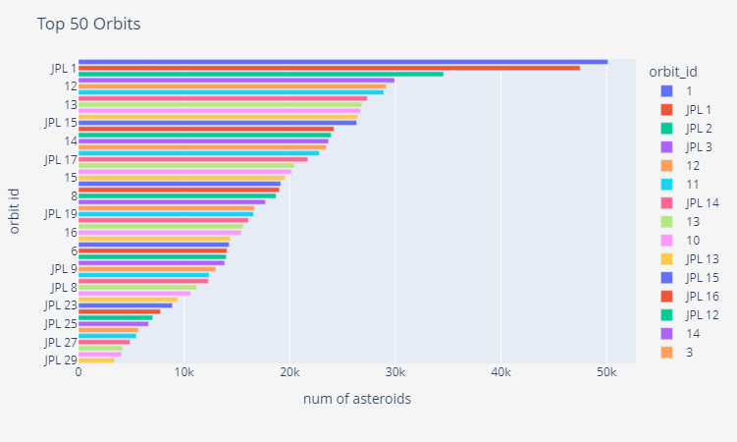
Dashboard Interpretation/Findings
Highlights percentage of asteroids that are/aren’t considered to be ‘near’ earth objects
Chart shows that a majority of 97.6% of asteroids are considered not to be near Earth
Less than 0.00004% of asteroids have not been determined
Small percentage in unknown values shows we have accurate data representation
Depicts the depicts the top 50 orbit ID’s
Demonstrates orbits that had the most asteroids revolving on them
We are able to narrow down our focus pertaining to the number of asteroids to be analyzed
Using top 50 orbit ID’s, we can find orbit coordinates and analyze corresponding asteroids proximities to Earth.
Notes:
Jaeline

Slide 21
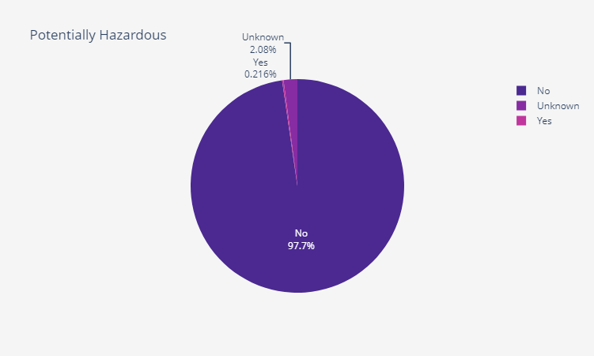
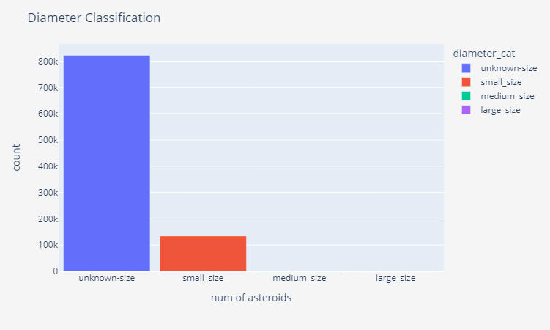
Dashboard Interpretation/Findings
Highlights percentage of asteroids that are/aren’t potentially hazardous
Chart shows that a majority of 97.7% of asteroids are considered not to be potentially hazardous
0.21% unknown value of asteroids have yet to be determined
Assists in filtering asteroids that require further analysis/metrics
Depicts the distribution of asteroid categories based on diameters
First bar includes over 800 thousand asteroids (unknown category)
Majority of known asteroids are of small size
Points to the inability to measure large diameters or asteroids being of small size overall.
Notes:
Jaeline

Slide 22
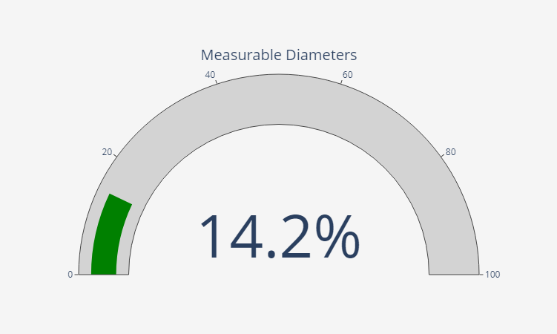
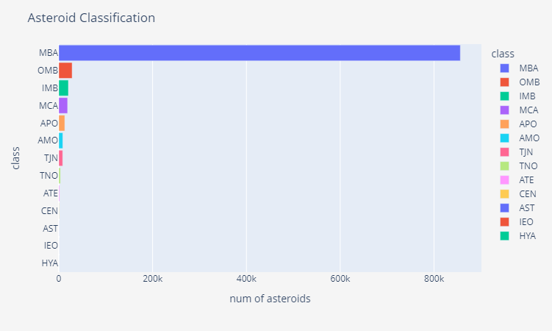
Dashboard Interpretation/Findings
Depicts that only 14.2% of asteroids have diameter values measured and recorded in the dataset
This can be due to either excessive sized asteroids unable to be measured or lack of prioritizing the diameter when capturing data
Shows asteroid classification by “class” in descending order
800 thousand asteroids(the majority) is in the MBA(main-belt asteroids) class
Large portion of asteroids in our dataset are orbiting between Mars and Jupiter
The main portion of the asteroid belt is closest to the Earth
Notes:
Jaeline

Slide 23
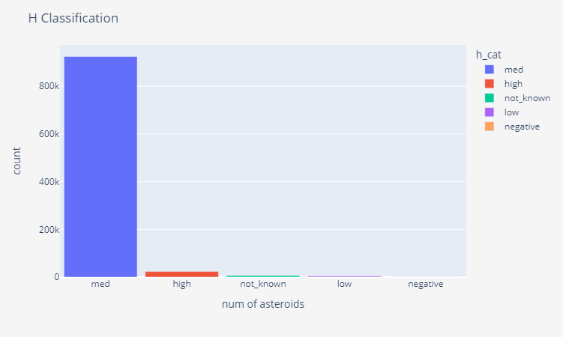
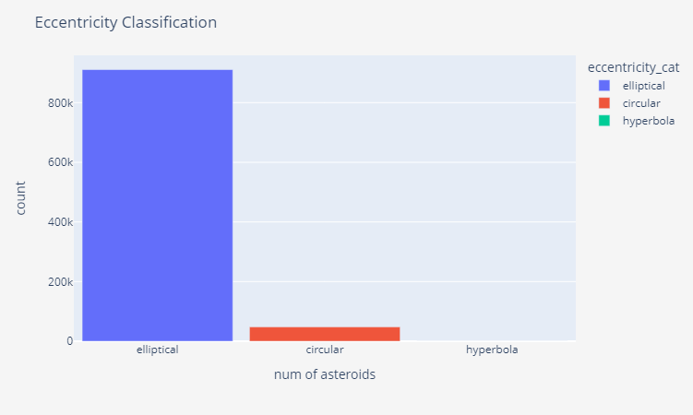
Dashboard Interpretation/Findings
Depicts the classification of asteroids based on they’re absolute magnitude
23 thousand asteroids have high magnitudes (20+)
Over 900 thousand asteroids have a medium magnitude (10-19.99)
Only 6000 asteroids have an unknown absolute magnitude
Shows the classification of asteroids based on their eccentricity
Eccentricity values are used to trace the path of asteroids and hence perceive the objects in path or at a distance that could be relatively at a risk of collision
900 thousand asteroids follow an elliptical path ( 0.05 > e < 1)
47 thousand have a circular path (e<0.05)
4 asteroids follow a hyperbolic path (e>1)
Notes:
Harsh

Slide 24
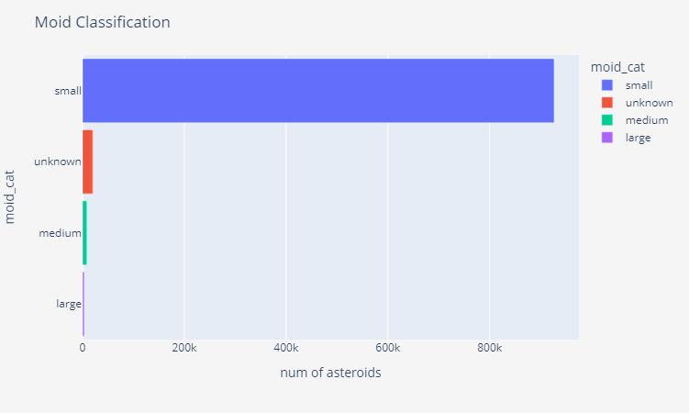
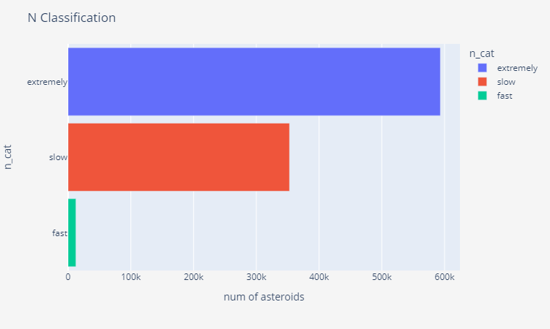
Dashboard Interpretation/Findings
The bar graph shows the Earth Minimum Orbit Intersection Distance
920 thousand asteroids are in the small moid category
20 thousand asteroids have an unknown moid which would require these asteroids to be further investigated to ensure collision with earth can be predicted
The visualization shows the asteroids classified by their angular speeds
593 thousand asteroids have an extremely slow angular speed
350 thousand have a slow speed
12 thousand have a fast speed
The angular speed is an important factor for classifying an asteroid as hazardous or not since a small asteroid at very high speed can pose a high risk
Notes:
Harsh

Slide 25
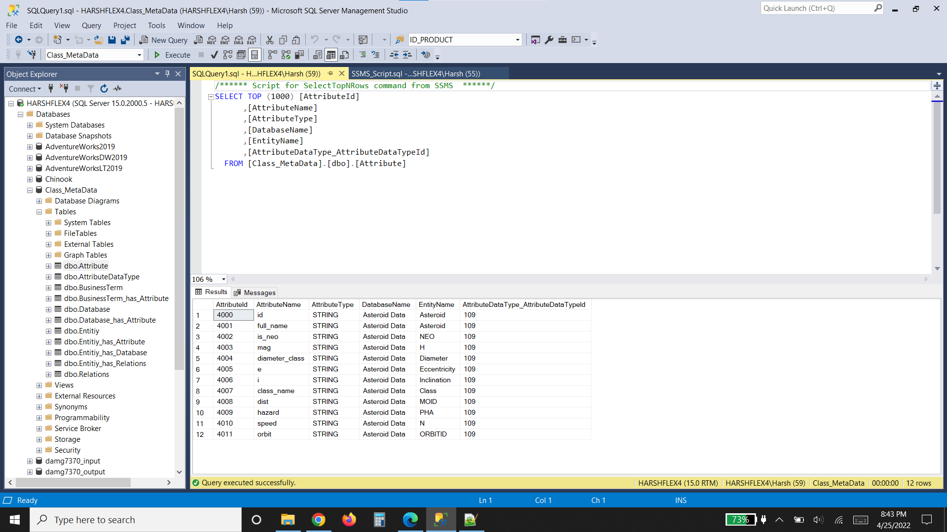
Loading metadata Into SSMS
Notes:
Harsh

Slide 26
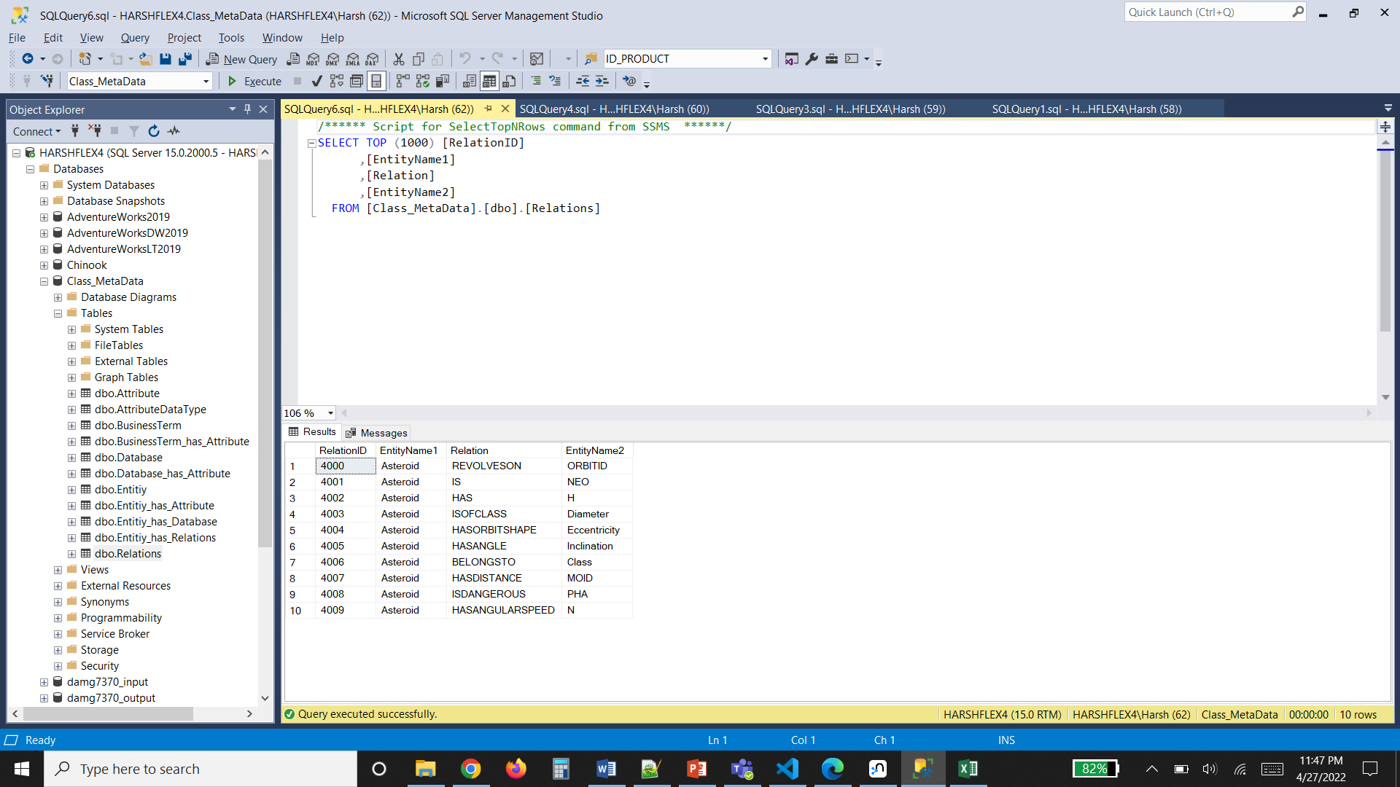
Loading relations into SSMS
Notes:
Harsh

Slide 27
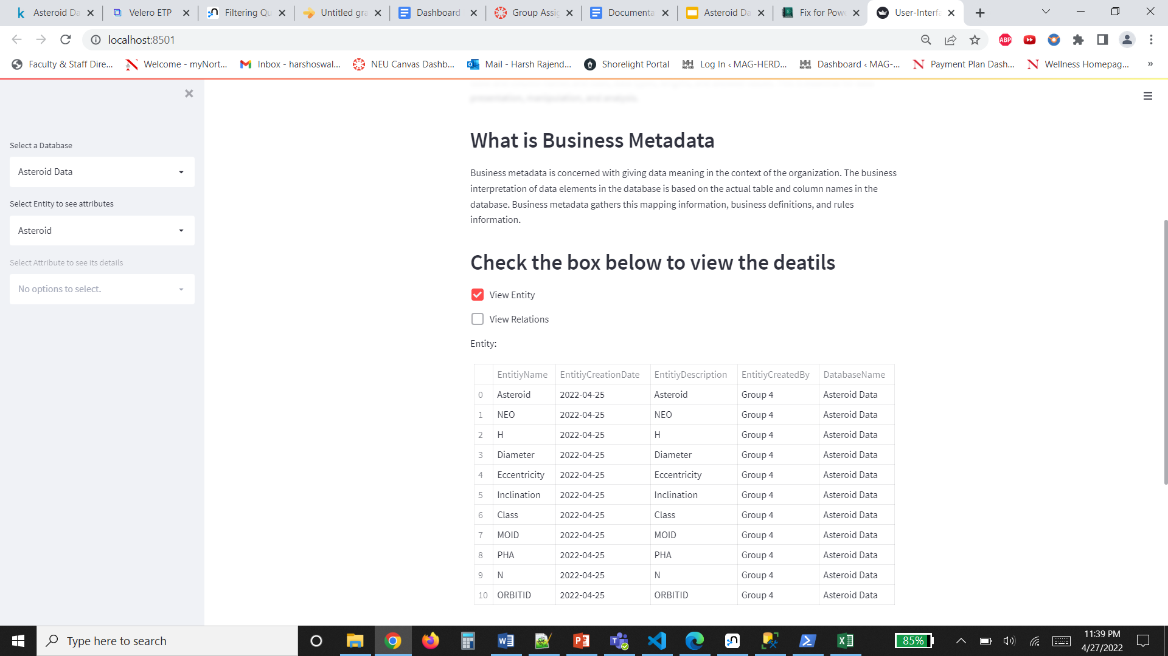
Metadata display using UI
Notes:
Harsh

Slide 28
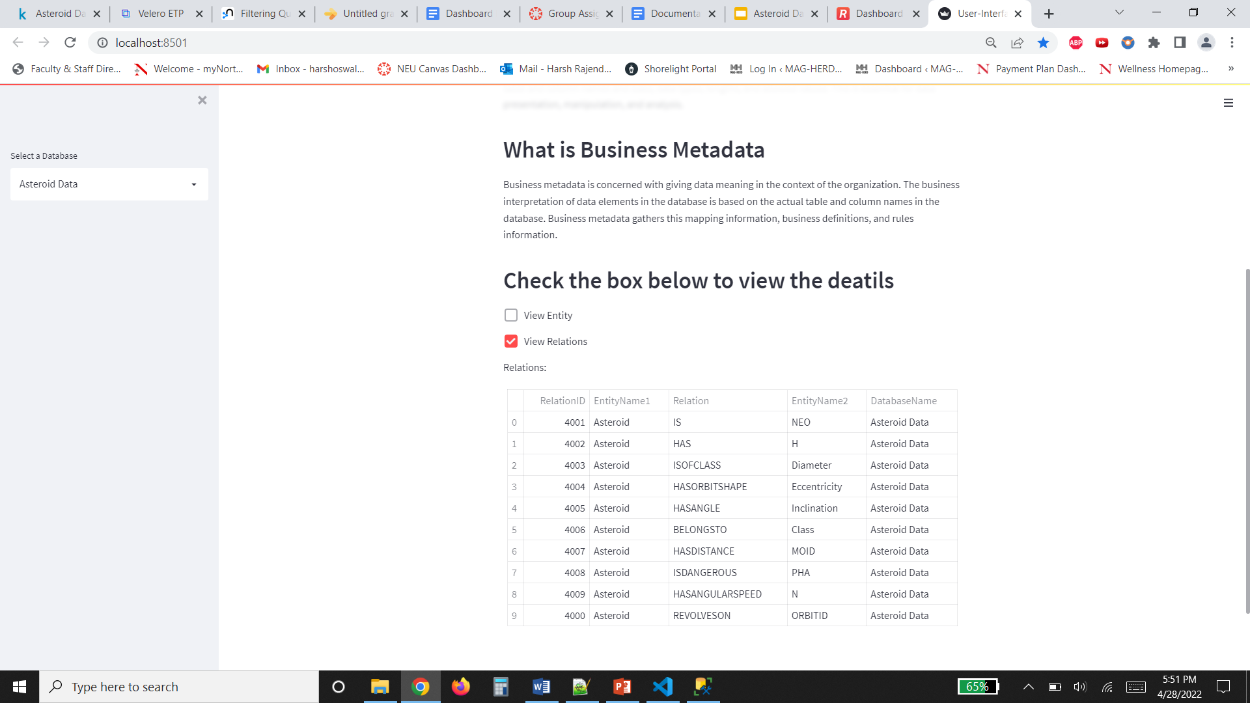
Displaying relations using UI
Notes:
Harsh

Slide 29
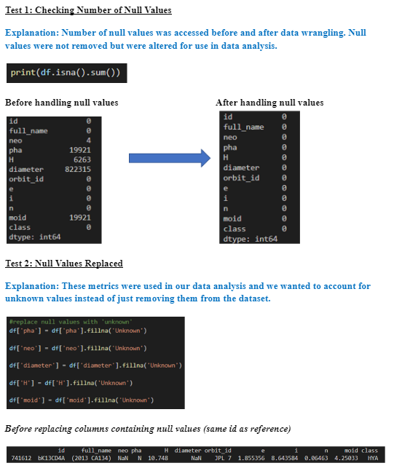
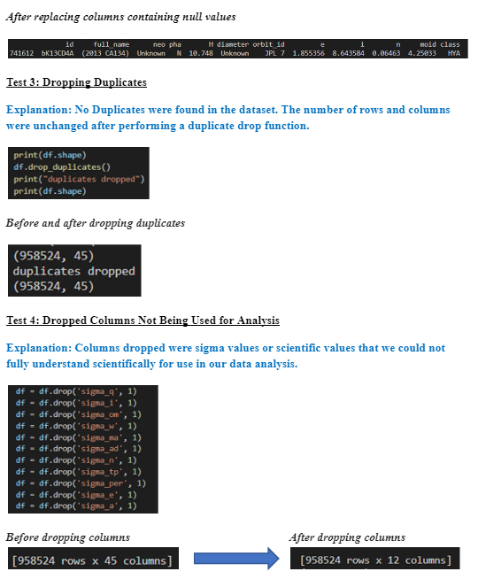
System Integration Testing and User Acceptance Testing
Notes:
Jaeline

Slide 30
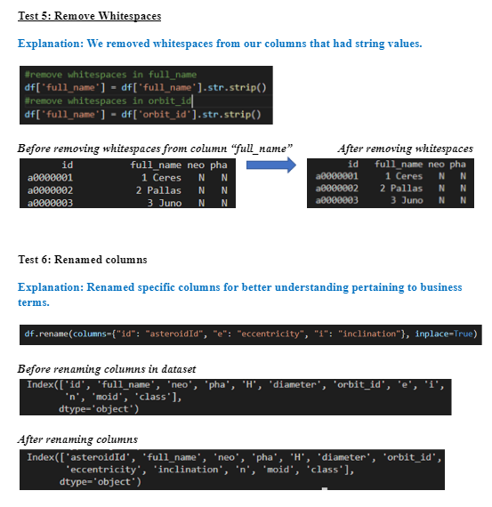
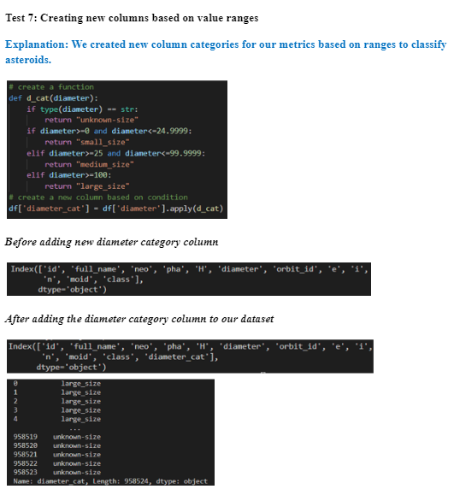
System Integration Testing and User Acceptance Testing
Notes:
Jaeline

Slide 31
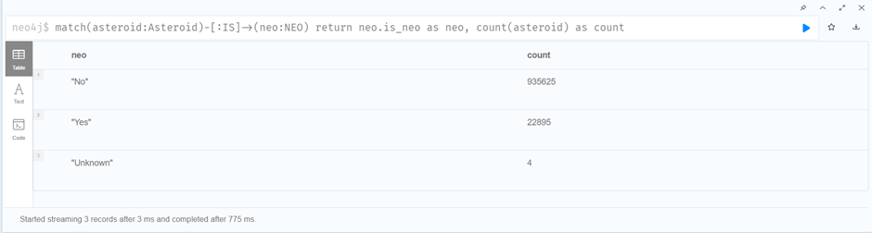
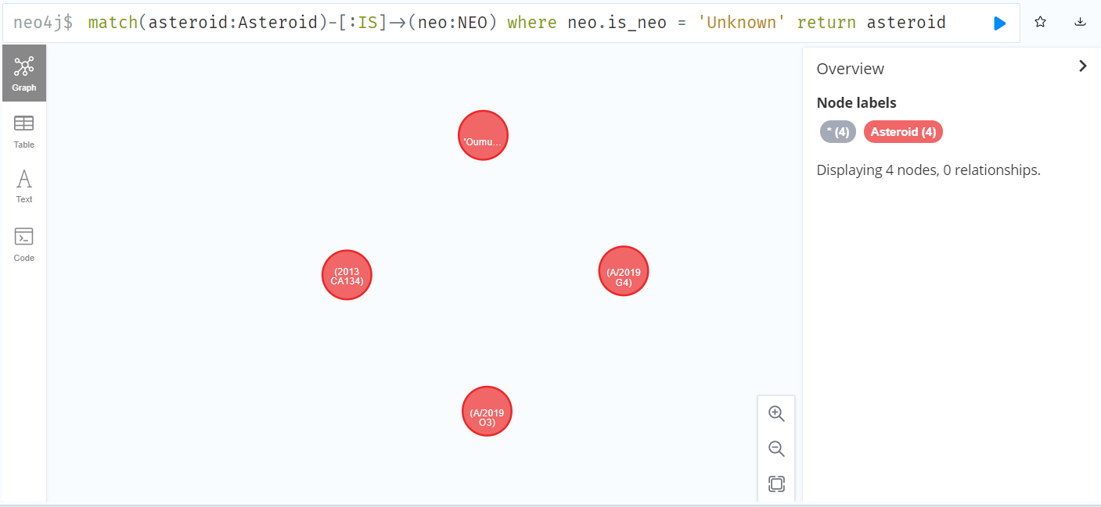
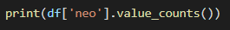
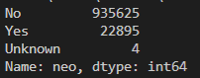
Neo4j Testing screenshots using Cypher Queries
Notes:
Harsh

Slide 32
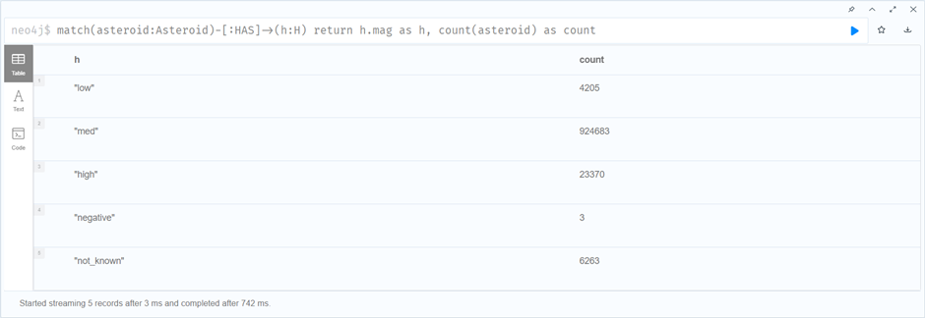
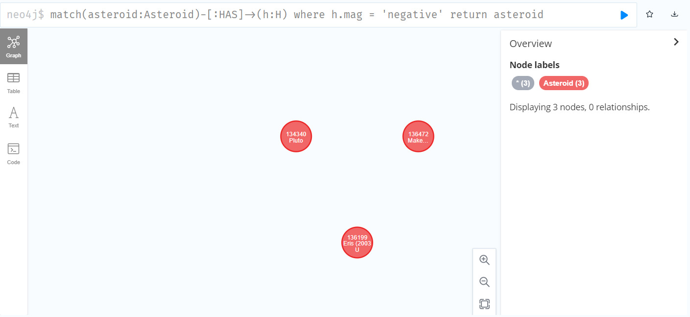
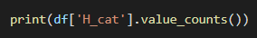
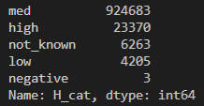
Neo4j Testing screenshots using Cypher Queries
Notes:
Harsh

Slide 33
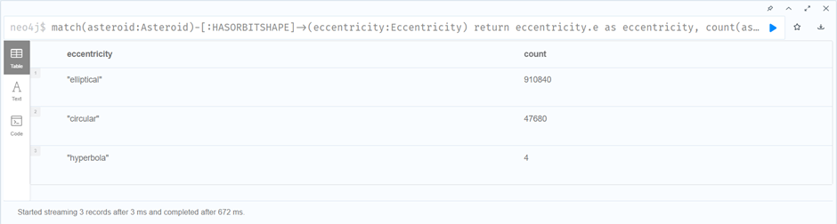
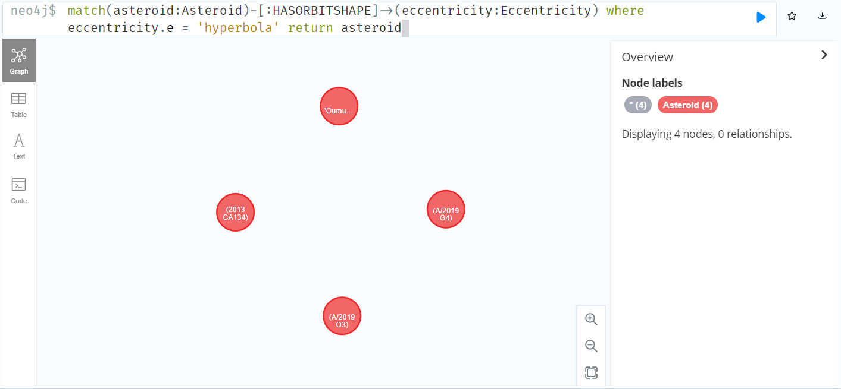
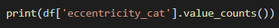
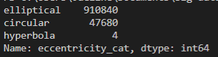
Neo4j Testing screenshots using Cypher Queries
Notes:
Harsh

Slide 34

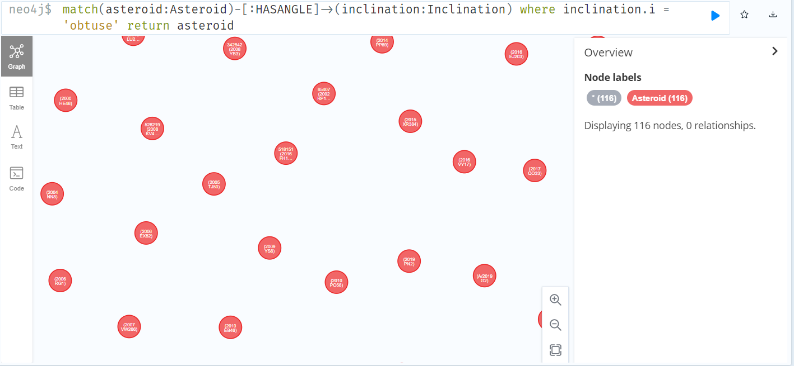
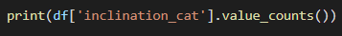

Neo4j Testing screenshots using Cypher Queries
Notes:
Harsh

Slide 35



Neo4j Testing screenshots using Cypher Queries
Notes:
Harsh

Slide 36
Risks/Issues
Type | Risk/ Issue -Description | Mitigation
Issue | Improper Environment setup for Data cleansing and data validation i.e., insufficient packages to run python scripts | Make sure all packages are installed and proper environment is set up to run all scripts error for data cleansing/wrangling process
Risk | Many fields needed to track asteroids details has missing data which might be an analytical risk leading to biased visualization | deriving new columns by understanding existing database attributes to generate reports without errors.
Risk | Inconsistent entries in data available for asteroids classification and thus analysis might be biased eventually which further leads to incomplete data merging or error in the creating graph database | Categorization of the range for available data records is to be done before loading data into the database.
Risk | Lack of Scientific Knowledge in terms of asteroids dataset among team members could lead to incorrect scientific analysis and interpretation | Prior research/study of astronomy and space for understanding dataset
Notes:
Divya

Slide 37

Risks/Issues (Velero Screenshots)
Notes:
Divya

Slide 38

Risk 1
Notes:
Divya

Slide 39

Risk - 2
Notes:
Divya

Slide 40

Risk- 3
Notes:
Divya

Slide 41

Issue
Notes:
Divya

Slide 42
Data Challenges
Difficulty understanding data context | Reference to Astronomy Data websites and Small-Body Database published by NASA
Lack of knowledge of scientific terms | NASA JSPL web page reference metadata used
Some columns containing 98% of null values | Accessed the value and dropped unwanted columns, alter values to be used for analysis
Many columns highly skewed when observing distribution | Classifying data into categories
Pinpointing data analysis focus for visualization | Selecting higher weightage metrics like NEO, PHA
Lack of qualitative data beyond asteroid id’s/names and general class | Create association by relations between data attributes
Notes:
Divya

Slide 43

Project Mandate

Slide 44

Project Mandate

Slide 45

Activity Management

Slide 46

Short Form - Velero

Slide 47

Long Form- Velero

Slide 48

Manage Plan

Slide 49


Timesheet

Slide 50

Resource Management

Slide 51
Thank You

